Slide 1

UML Diagrams for Task Management System
Made by,
Divy Patel - INT_1056

Slide 2
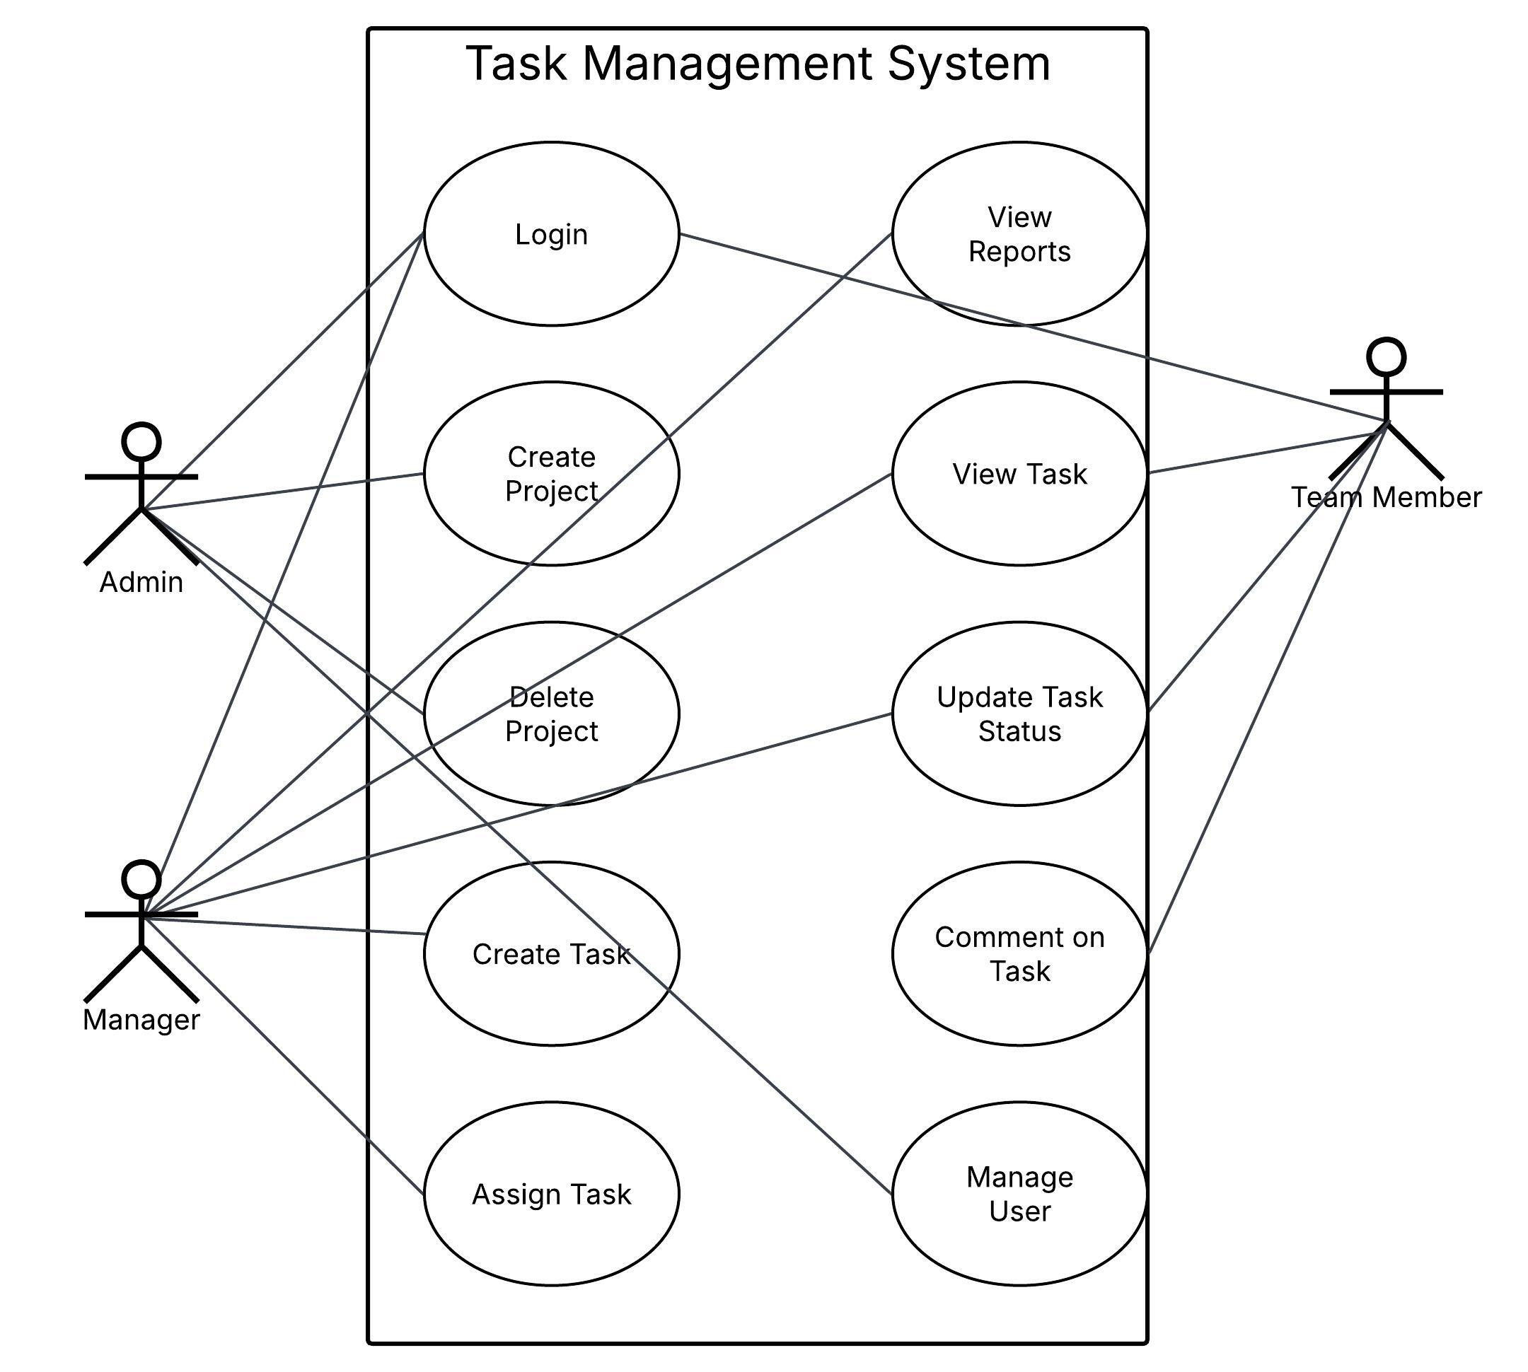
Use Case Diagram:
Total types of users
- Admin
- Project Manager
- Team Member

Slide 3
Total six activity diagrams:
1. Login Process
2. Manage Users
3. Create Project
4. Task assignment (Manager Workflow)
5. Team Member Task Completion
6. Delete Project
There will be more then one Activity Diagram:
Why? Because we cannot define every process in a single diagram, It becomes too lengthy and complex

Slide 4
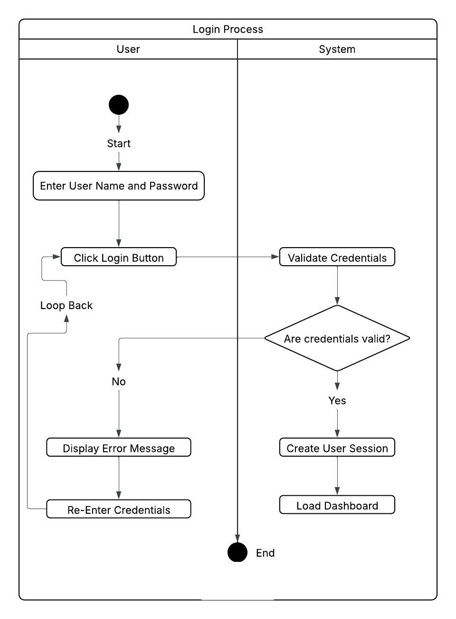
Login Process Activity Diagram:

Slide 5
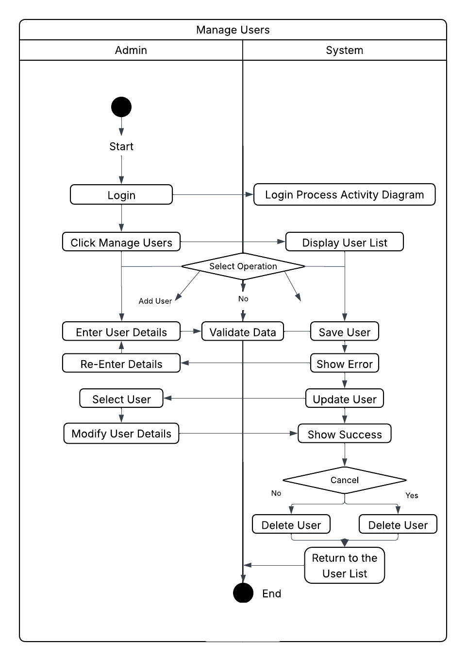
Manage Users Activity Diagram:

Slide 6
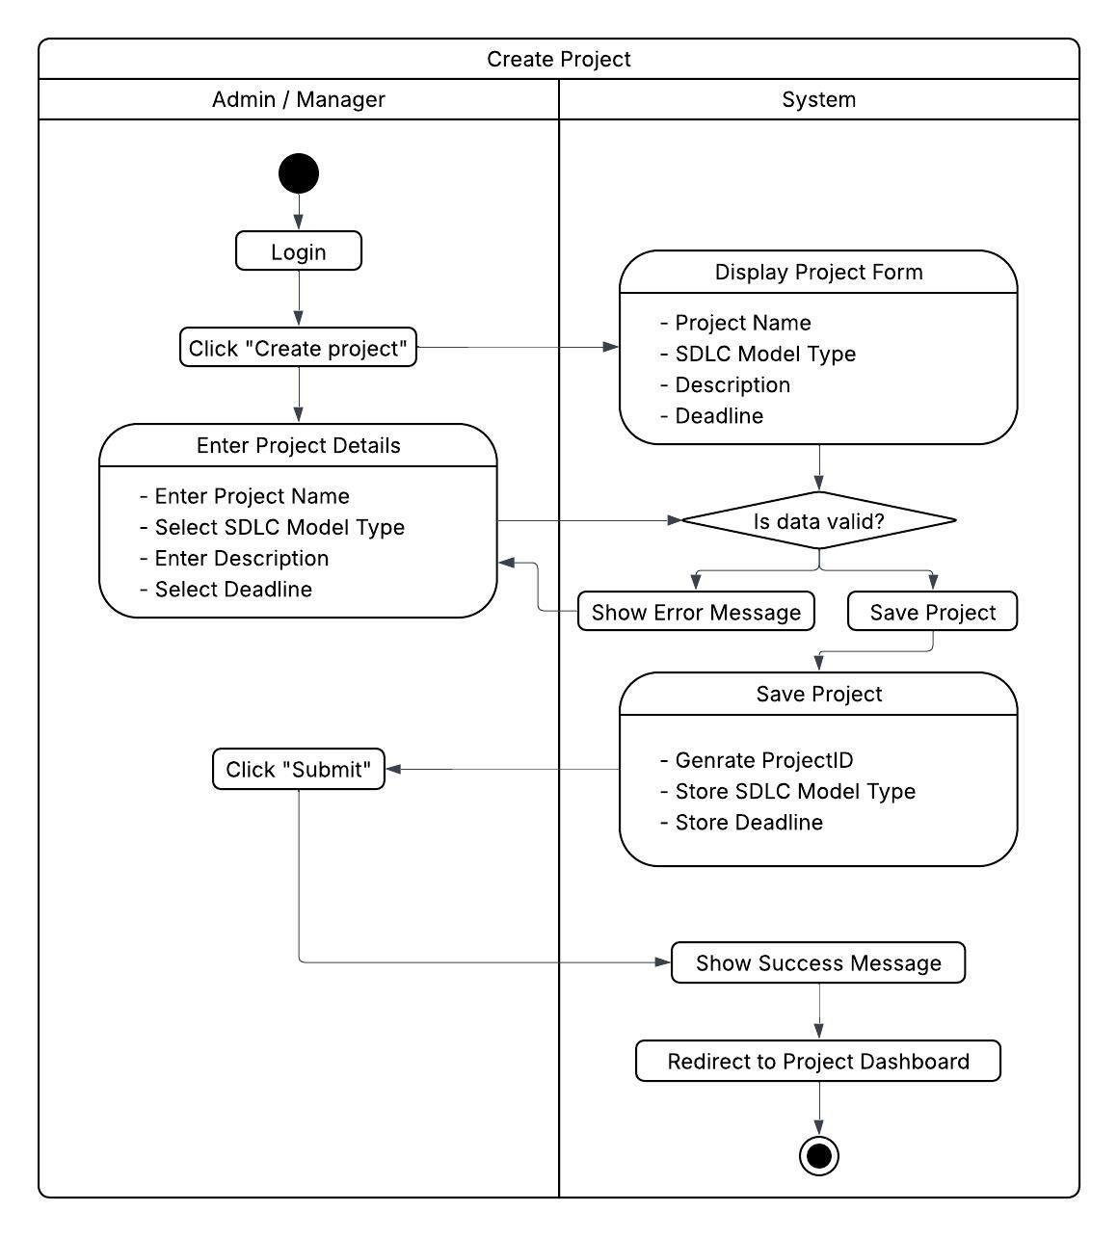
Create Project Activity Diagram:

Slide 7
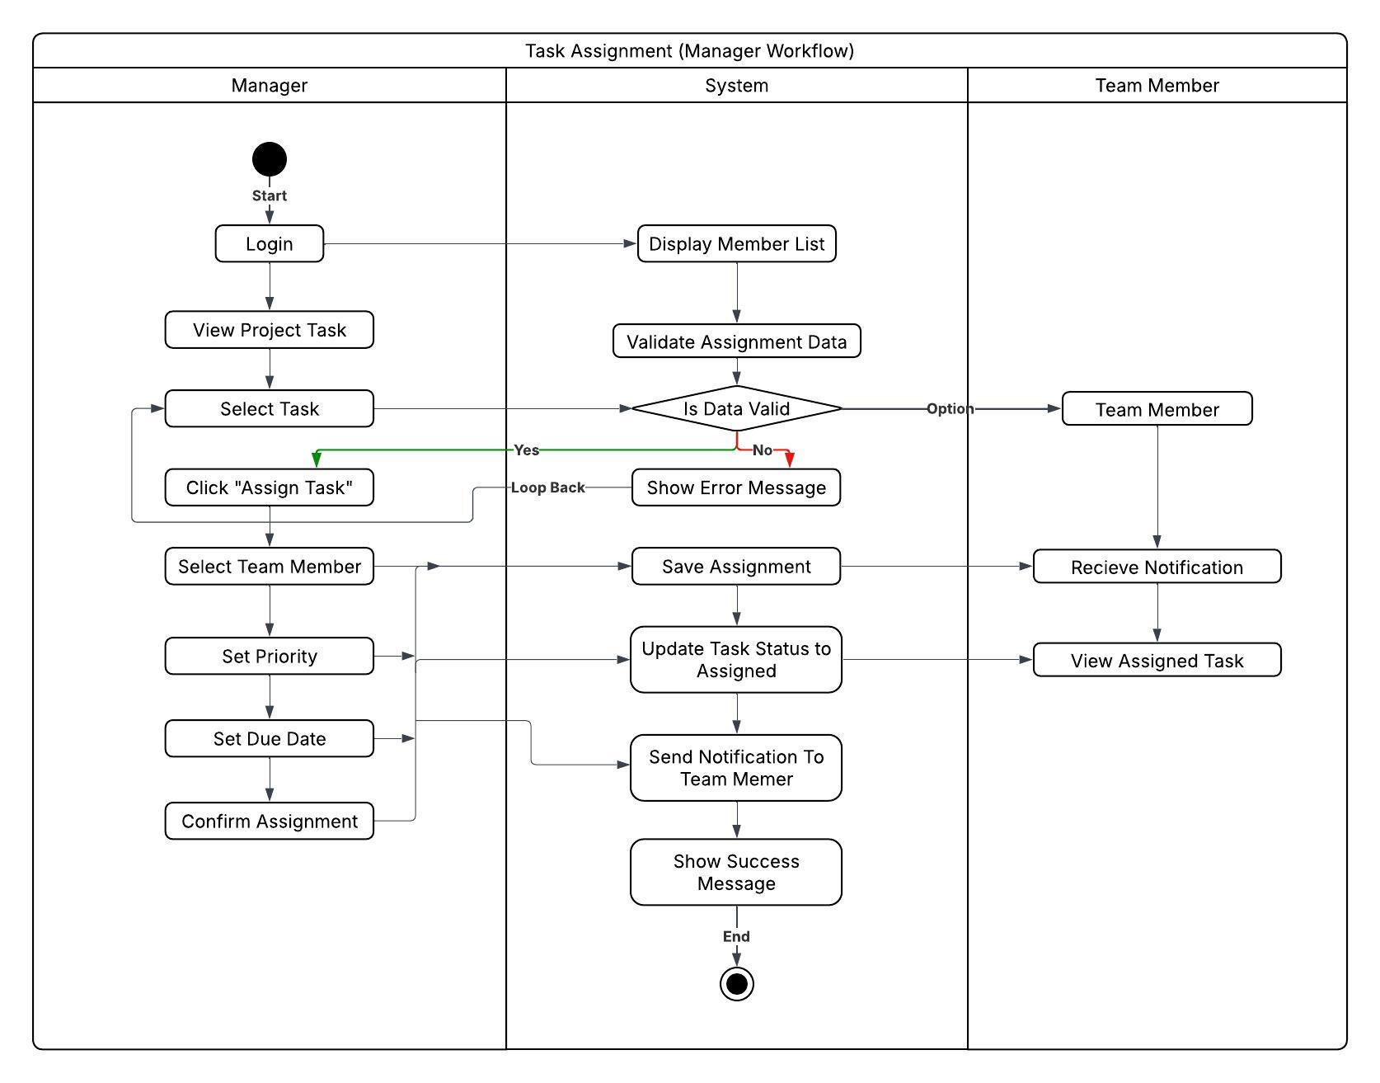
Task assignment Activity Diagram:

Slide 8
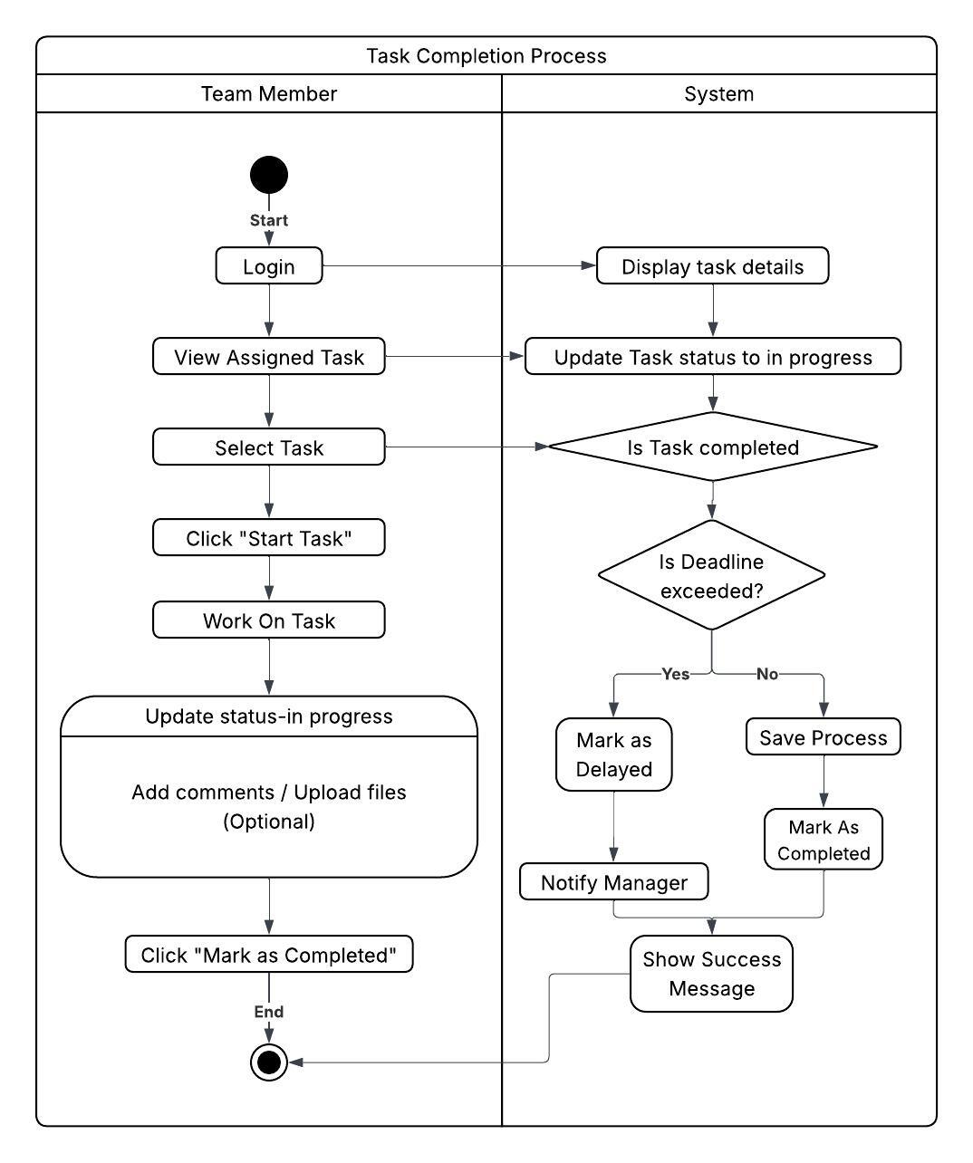
Team Member Task Completion Activity Diagram:

Slide 9
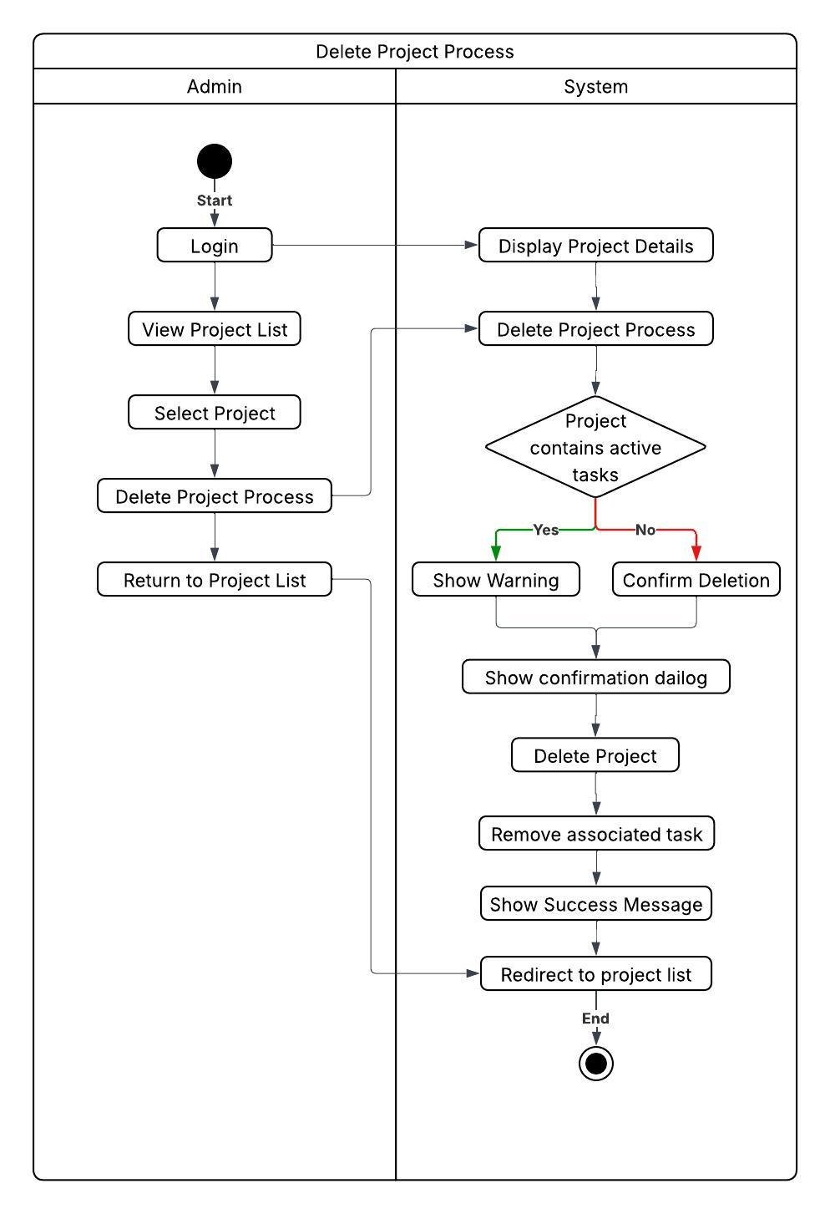
Delete Project Activity Diagram:

Slide 10
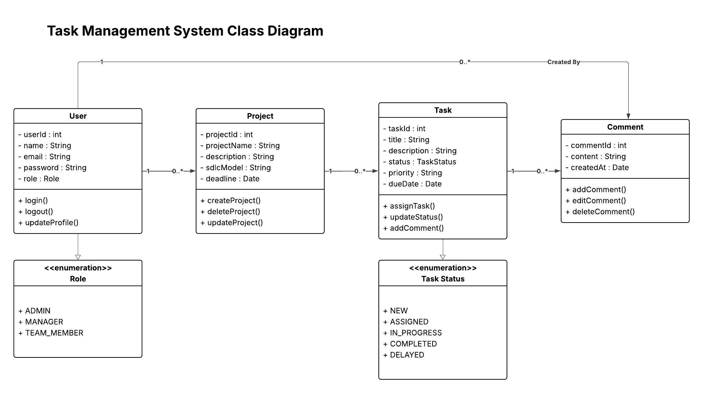
Class Diagram

